Slide 1
Convex optimization of process variables to reduce warpage in fused deposition modeling
Pranav Addepalli

Slide 2
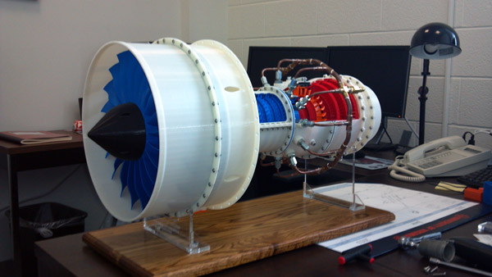
Background
3D printing is crucial for many industries
Construction
Medicine
Robotics
Aerospace
Defense
http://www.3dprinterworld.com/article/3d-printing-enables-university-students-become-aerospace-manufacturers

Slide 3
Background
Fused Deposition Modeling
Most common printing method
Melts a thermoplastic filament repeatedly
Polylactic Acid
Most common filament
Made from renewable lactic acid
https://www.3dnatives.com/en/fused-deposition-modeling100420174/

Slide 4
Background
FDM prints layer by layer, creating thermal cycles
Cooling → Contraction → Mechanical stress
Heating → Expansion → Mechanical stress
Greatest stress in corners
This is called warpage
https://www.3dhubs.com/talk/t/adhesion-and-upward-warping-problems/4334

Slide 5
Thermal properties are important to understand!

Slide 6
My Project
Studying multiple print parameters
Infill density
Infill pattern
Effect on temperature distribution
PLA discs during printing process
https://www.dddrop.com/wp-content/uploads/2018/02/3D-printen-stevige-infill.jpg

Slide 7

My Project
Optimize values for the print parameters
Visualize, model, find trends in
spatiotemporal temperature data
and heat flow trajectories
Find the best parameters and print test discs

Slide 8
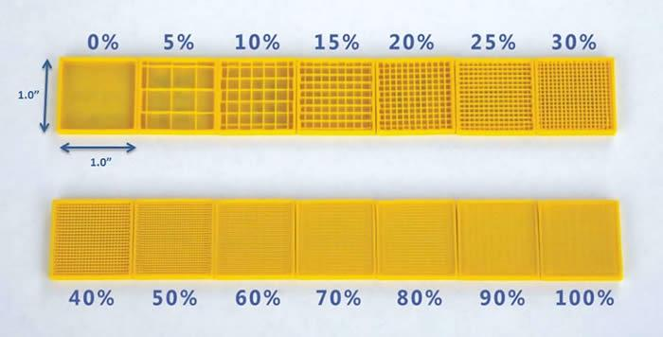
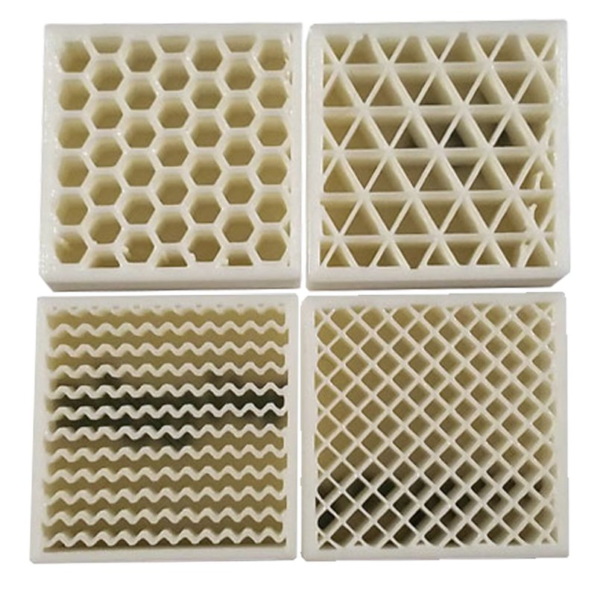
Variables
Infill type (grid vs. hexagonal)
Infill percentage (10%, 20%, 30%)
https://3dprinting.com/tips-tricks/how-to-choose-an-infill-for-your-3d-prints/
http://tcadsolutions.com/3dprinting.html

Slide 9
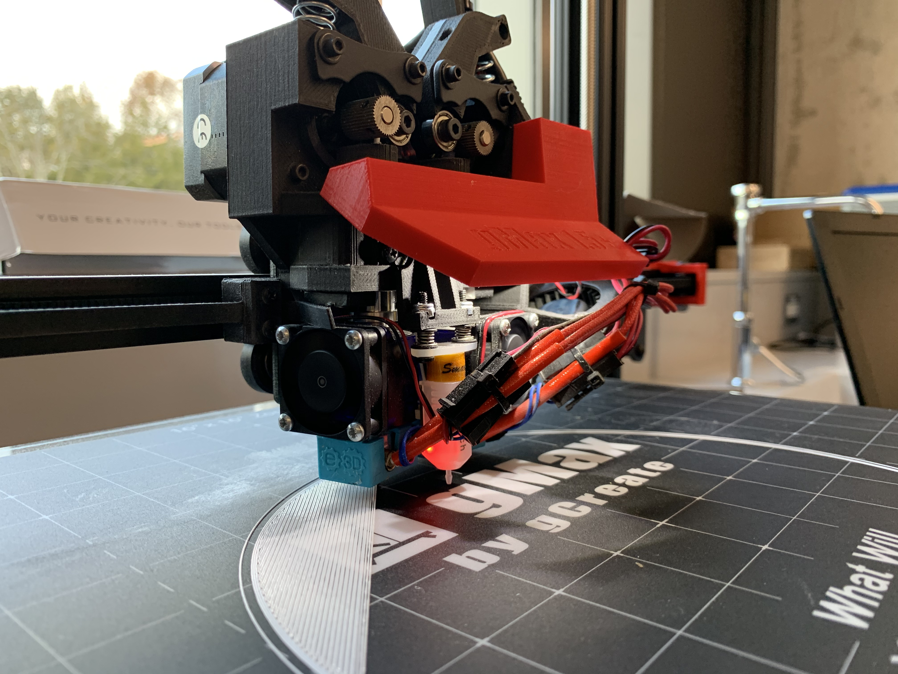
Materials
NTC Thermistors
Hatchbox PLA
Arduino Uno R3 (with breadboard)
gCreate gMax 1.5 XT+

Slide 10
4 Phase Procedure
Design
Data Collection
Modeling
Data Analysis

Slide 11
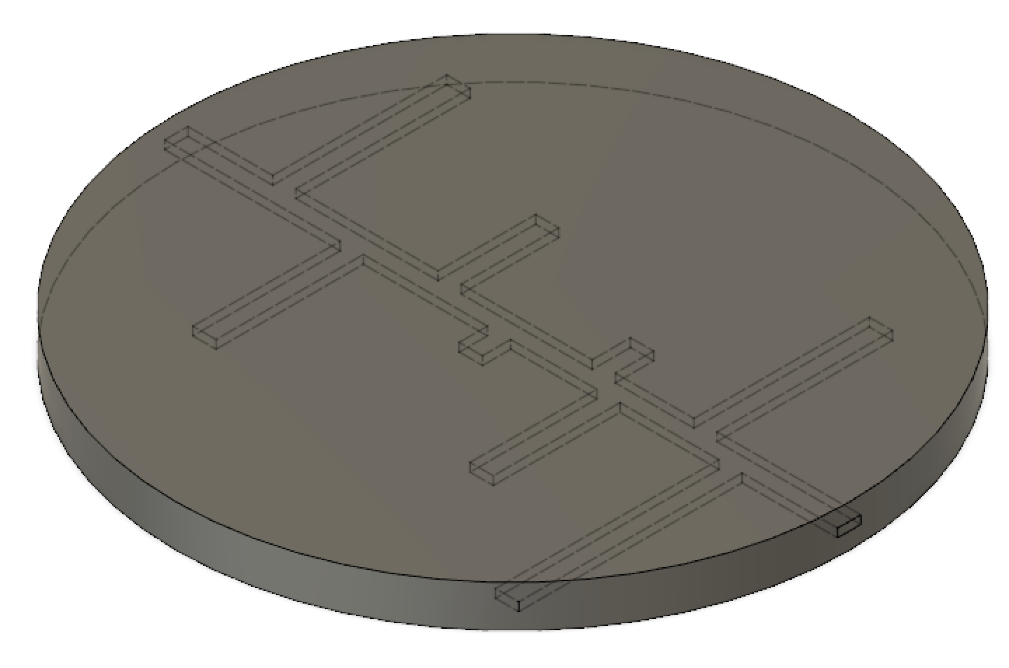
1) Design
Designed CAD models in Fusion 360
8 inch diameter
0.5 inch thickness
Channels along circles for thermistors
Sliced disc with different print parameters in Ultimaker Cura
Created a temperature measurement system with an Arduino

Slide 12
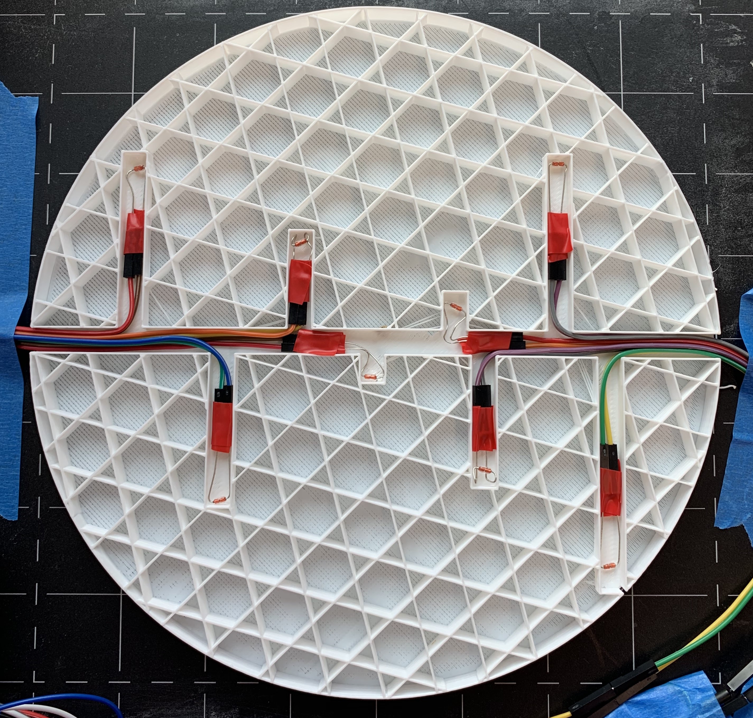
2) Data Collection
Halfway through the printing process:
Embedded thermistors
Connected to Arduino system
Began recording temperatures
Repeated for all discs (10%, 20%, 30%, lines, and trihexagonal parameters)

Slide 13
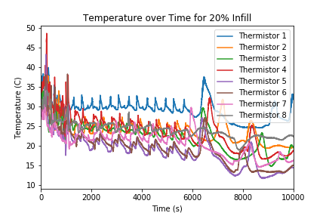
3) Modelling
Processed the data and extract temperature-time pairs
Attributed locations and create models for temperature distributions
Created models for heat flow trajectories
Due to the large amount of data (over 400 thousand individual points), this was done in Python

Slide 14
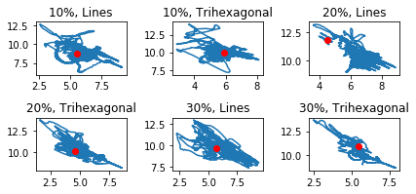
3) Modelling The Temperature-Weighted Mean Model
At any time t, the temperature and position is known at 8 points on the disc
Like the center of mass, we can find a “center of temperature”
Repeat for every measurement time for each disc to see the position of the center of temperature over time

Slide 15
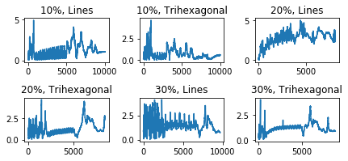
3) Modelling Distance Analysis
Based on data recorded during a steady-state, the equilibrium center of temperature can be found
For every time t, the distance from the center of temperature to the equilibrium point can be calculated
Theoretically, smaller distances means that the disc is less likely to experience warpage

Slide 16
4) Data Analysis Comparing Mean Distances
Cost function f : Euclidian distance from an equilibrium point to a weighted temperature center at time t
By comparing the mean distances for each disc, we can find the best parameters for warpage reduction
Student’s t-test with Independent Samples was used

Slide 17
t-test Results
Sample 1 | Sample 2 | p | T
10% Lines | 10% Trihexagonal | 0 | 48.293
20% Lines | 20% Trihexagonal | 0 | 127.985
30% Lines | 30% Trihexagonal | 2.137 x 10⁻²⁵² | 34.499
10% Lines | 20% Lines | 0 | -140.179
20% Lines | 30% Lines | 0 | 120.111
10% Trihexagonal | 20% Trihexagonal | 0 | -53.354
20% Trihexagonal | 30% Trihexagonal | 1.692 x 10⁻⁷ | 5.233

Slide 18
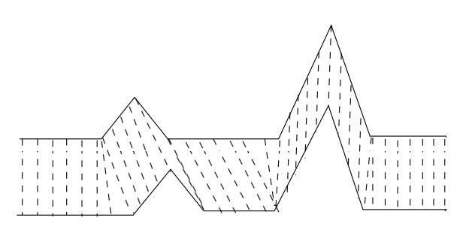
4) Data Analysis Dynamic Time Warping (DTW) for Heat Flow Trajectory Analysis
DTW is an algorithm that measures similarity between two temporal sequences
DTW was used to compare the movement of centers for each disc (heat flow trajectories)
Implemented in Python using the FastDTW library
Similarity scores are found using distances (lower = more similar)
https://en.wikipedia.org/wiki/Dynamic_time_warping#/media/File:Dynamic_time_warping.png

Slide 19
DTW Results
Sample 1 | Sample 2 | Similarity Score
10% Lines | 10% Trihexagonal | 13654.523
20% Lines | 20% Trihexagonal | 12627.314
30% Lines | 30% Trihexagonal | 9859.541
10% Lines | 20% Lines | 16607.523
20% Lines | 30% Lines | 12024.950
10% Trihexagonal | 20% Trihexagonal | 6309.220
20% Trihexagonal | 30% Trihexagonal | 3997.648

Slide 20
Conclusions With very low p-values, this study supports the following claims:
Trihexagonal is a better infill pattern for reducing warpage (Distance Analysis)
20% is the worst infill density for reducing warpage, with 10% being the best (Distance Analysis)
As infill density increases, the effect of infill pattern falls (DTW)
The difference between 10% and 20% is larger than the difference between 20% and 30% (DTW)

Slide 21
Future Work
More trials are required to verify that these results are reproducible
Further studies are necessary to identify the role of natural convection in 3D printing and its effects on warpage
More variables can be studied for a wide range of parameters to analyze, including wall thickness and layer height

Slide 22
References
Zhang, J., Wang, X. Z., Yu, W. W., Deng, Y. H. (2017). Numerical investigation of the influence of process conditions on the temperature variation in fused deposition modeling. Materials & Design, 130, 59-68. doi:10.1016/j.matdes.2017.05.040
Deng, C., Kang, J., Shangguan, H., Hu, Y., Huang, T., Liu, Z. (2018). Effects of hollow structures in sand mold manufactured using 3D printing technology. Journal of Materials Processing Technology, 255, 516-523. doi:10.1016/j.jmatprotec.2017.12.031
Vaughan, N. & Gabrys, B. (2016). Comparing and combining time series trajectories using Dynamic Time Warping. Procedia Computer Science, 96, 465 – 474. doi:10.1016/j.procs.2016.08.106
Studer, M & Ehrig, F. (2014). Minimizing part warpage in injection molding by optimizing wall thickness distribution. Advances in Polymer Technology, 33. doi:10.1002/adv.21454

